Slide 1

PDC 2026 • WINNIPEG
AGENTIC SDLC ACROSS
GITHUB AND AZURE
AI-Driven Hypervelocity Engineering Without Chaos
This talk is not is not about writing code faster.
It is about what happens after code generation becomes fast.
Alex Drenea
Solutions Architect • Microsoft
Notes:
## Slide 1 — AGENTIC SDLC ACROSS GITHUB AND AZURE
This is a talk about AI-driven engineering, but it is not a talk about generating more code. It is about what happens after generation becomes cheap: context has to be reconstructed, decisions have to be reviewed, changes have to be verified, production has to be protected, and whatever we learn has to survive the chat that produced it.
Hypervelocity engineering is not just typing code faster. It is designing an engineering system in which context, constraints, agents, verification, and learning safely compound.”
I want to start with the moment this approach shined, because that is where its engineering value becomes visible.

Slide 2
Sixteen minutes from approved change to verified recovery
OPENING INCIDENT
6:39pm
6:43pm
6:46pm
6:50pm
6:52pm
6:55pm
I approved
a change
I approved
a change
Restart exposed
missing settings
Customer-visible
503
Root cause
identified
Configuration fixed
and verified
Production
restored
1
ROOT CAUSE
2
WHY IT HID
A collection-replacement operation wrote one setting and removed the rest.
The old worker stayed healthy until restart. The new worker could not boot.
16 min change → recovery
~9 min observed 503
Automation amplifies both delivery speed and failure speed
Notes:
At 06:39pm, I approved a production configuration. At 06:43, a restart exposed a startup failure. At 06:46, the service was returning 503. By 06:50, the cause was understood. By 06:55, the complete configuration had been restored and the service was healthy.
That is sixteen minutes from approved change to verified recovery. The clearly observed customer-visible 503 window was about nine minutes.
So, *i* just took prod down! Seems pretty mundane right? Can happen to anyone, *has* happened to everyone... The kicker is, even though I was responsible for breaking it.. *and* fixing it, I had a single interaction with the system. Can anyone guess what was my contribution?...
Pause for effect.
Slide animation - highlight the word "approve.".
Here’s what happened. While troubleshooting a bug, the agent recommended a secret needed to be added to the web app configuration. I approved the change. The agent used a PUT command instead of PATCH to update the settings collection which caused the entire collection to be replaced. The command succeeded and an immediate API test showed success because the worker had not yet restarted. The problem became visible only when the application restarted and a new worker tried to boot without required settings.
Five minutes in, the app started behaving strangely with requests failing “out of the blue”
Health probes, telemetry, and startup logs were all used to narrow the fault. The Agent repaired the full declarative configuration, restarted, and verified health.
But this is what makes this extraordinary... Yes the human approved, and yes the agent made a mistake, not a hallucination, an honest mistake, but the engineering rigor built into the agentic workflows allowed this to self heal and end in a healthy and corrected state - not a rollback.
And the lessons, while they are ordinary engineering lessons: validate the response shape in read-modify-write APIs; back up configuration, treat restart as part of the success confirmation process ; and remember that an exit code is not evidence that the product is healthy - have been automatically recorded and will be used in the future to reduce the chances of this happening again .
### Transition
This incident changed my definition of velocity…. Hypervelocity is not how quickly an agent can make a change. It is how quickly the engineering system can move from intent to verified outcome—and recover when the outcome is wrong.
Automation amplifies both delivery speed and failure speed which means you need to ensure you provide the rigth tools to amplify the speed at every layer of the SDLC.

Slide 3
Hypervelocity is not code velocity
REFRAME THE GOAL
THE TEMPTING METRIC
THE ENGINEERING METRIC
Prompt → code
Intent → evidence → learning
Fast generation can simply move work downstream into review, testing, integration, deployment, and recovery.
Correct, reviewable change
Verified deployment identity
Operational feedback
Reusable lesson in the repository
LOCAL OPTIMUM
SYSTEM OPTIMUM
Notes:
## Slide 3 — Hypervelocity is not code velocity
AI is very good at compressing the time from a request (aka the prompt) to a plausible change (the code it wrote).
But that does not automatically make it correct, reviewed, or releasable. So, for that code to be useful we need to review, test, integrate, etc… which means we’re simply “kicking the can down the road”. I am not saying to verify less, I am saying to ‘design verification into the path earlier, automate what can be deterministic, and route the right context before work begins.’
So, our real metric should not be generated code – it should be “evidence” – things like a code that passes a review gate, tests that cover the entire contract of the change, that pass, evaluations around nondeterministic behaviors, even non-code elements such a complete and correct ticket.
And then there is a second loop – Just as important-> What did we learn, and where does that lesson go?
If it stays in my head or in an old session, the next agent and the next engineer pay the same discovery cost again.
If it becomes an issue constraint, a test, an instruction, a skill, an architecture decision, the repository gets smarter over time.
So my working definition is: True AI driven hypervelocity engineering is the shortest safe path from intent to trusted evidence, followed by the shortest path from that evidence to reusable organizational knowledge.”
### Transition
Here is what that evolution looked like in a real product—and first, what the evidence can and cannot tell us.”

Slide 4
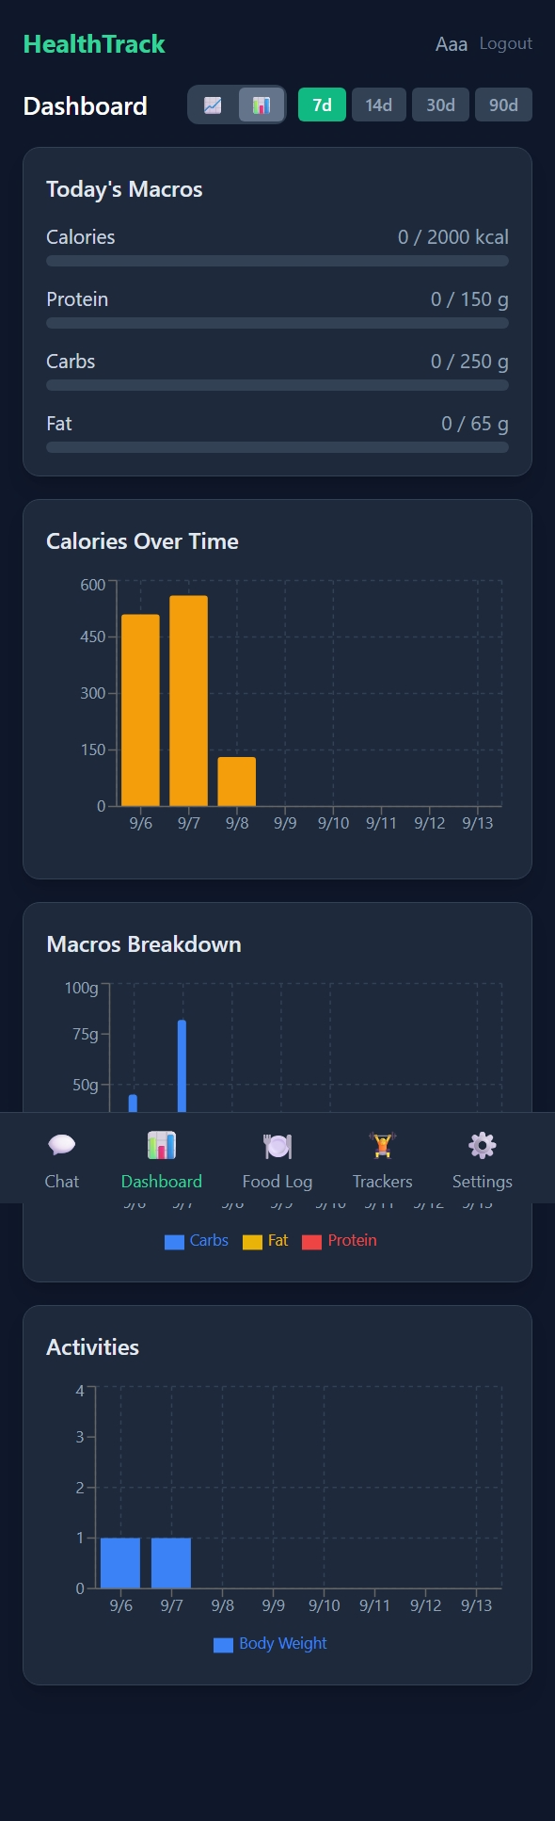
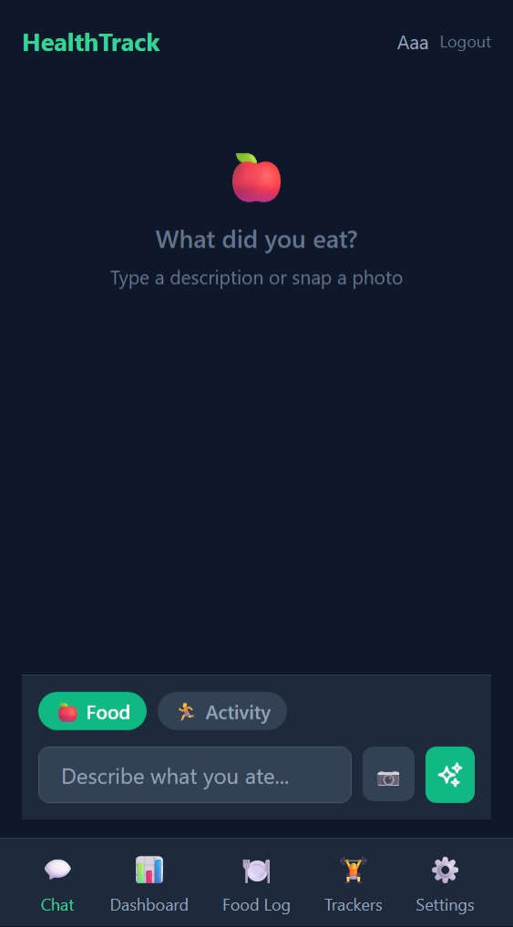
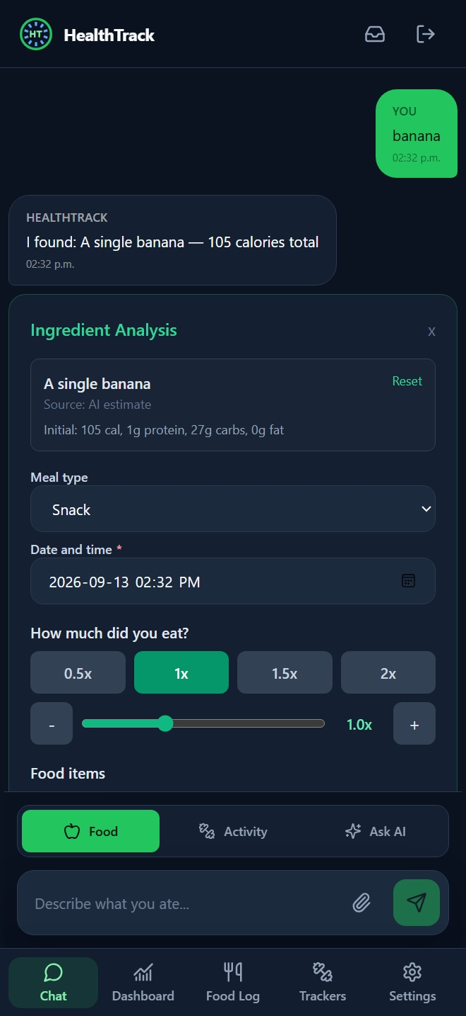
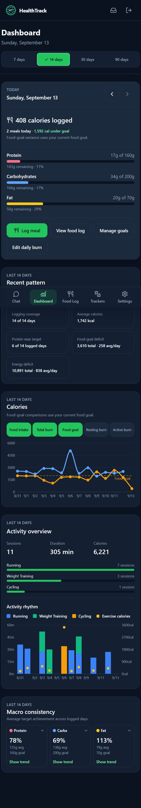
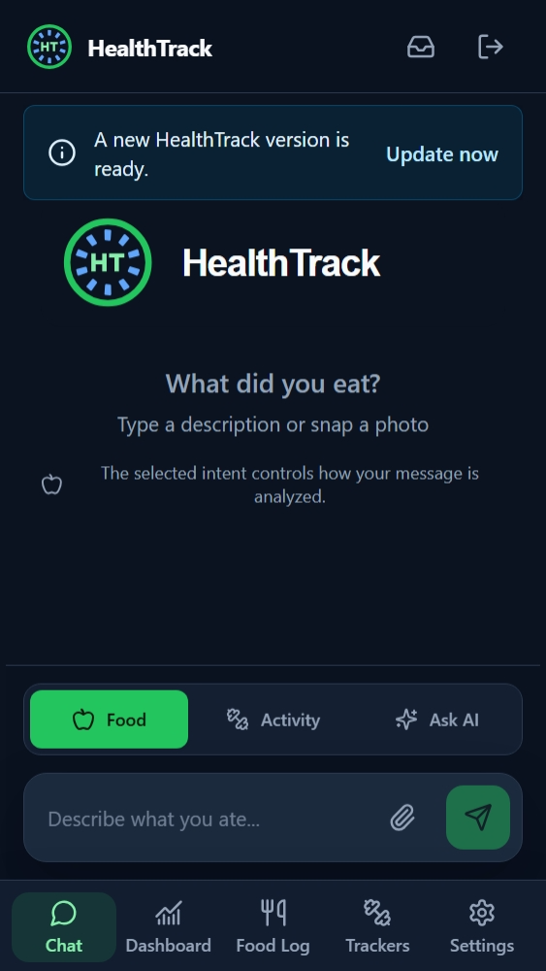
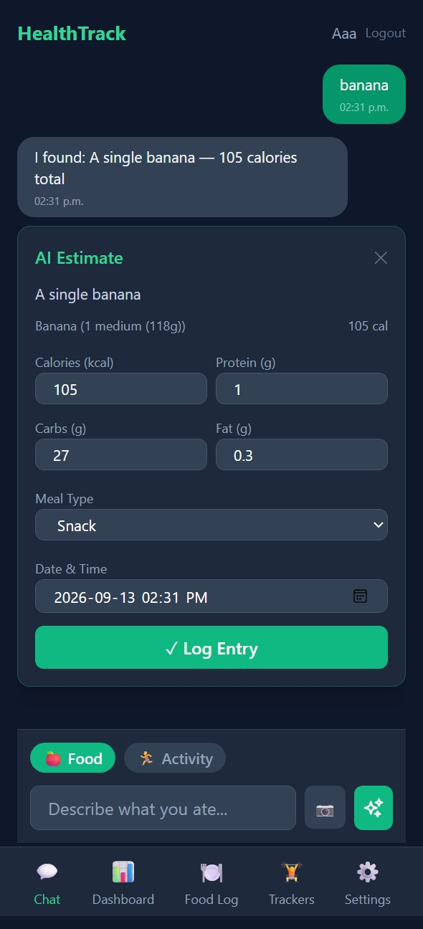
Health Track – a perfect HVE test bench
SCOPE THE CASE STUDY
Notes:
## Slide 4 — Health Track – a perfect HVE test bench
## Slide 4
“This started as a small, personal vibe-coded application and grew into a real product with enough complexity to test an agentic SDLC honestly.
Story
As the product became real, the way I worked with the agent also had to become real.

Slide 5
Evidence, not a productivity claim
SCOPE THE CASE STUDY
44
657
430
80 / 80
Health Track sessions
in the observed 30-day window
Recent commits / commits with
Copilot co-author trailer
Recorded turns
Session file-touch total
What the evidence can support
A concrete evolution of practices • repeatable failure and recovery stories • controls that caught real defects • friction exposed by reuse
What it cannot support
Organization-wide ROI • controlled comparison against non-AI work • elimination of human review • universal best practice
These are activity signals. They do not prove productivity, quality, or causation.
Notes:
## Slide 5 — Evidence, not a productivity claim
These are measured activity counts from a recent thirty-day window, not productivity metrics.
Health Track had 44 recorded sessions, 657 recorded turns, and 430 session file touches. In the recent Git window, Health Track had 80 commits; all 80 contained Copilot co-author attribution. The broader observed activity included substantial delegated review and work across frontend, backend, PWA, AI, data, infrastructure, release, operations, and migration.
What does that prove? It proves that this operating model was used to deliver substantial full-stack change and that it generated concrete engineering controls.
What does it not prove? It does not show that one developer became some multiple faster. There is no controlled non-AI comparison. Co-author trailers do not prove quality or causation. Much of the independent review was AI-on-AI with human approval. These is a private personal products, not an enterprise-wide study.
I am showing the counts to define the scale of the experience, not to manufacture an ROI claim.”
“The important evidence is not the volume. It is the change in the operating system.”

Slide 6
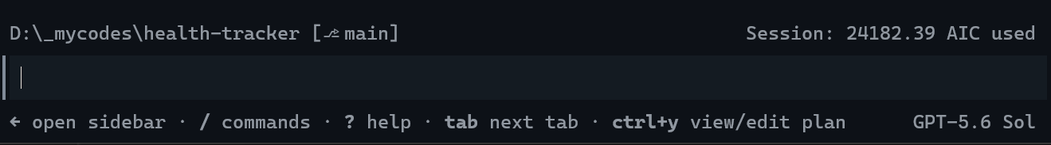
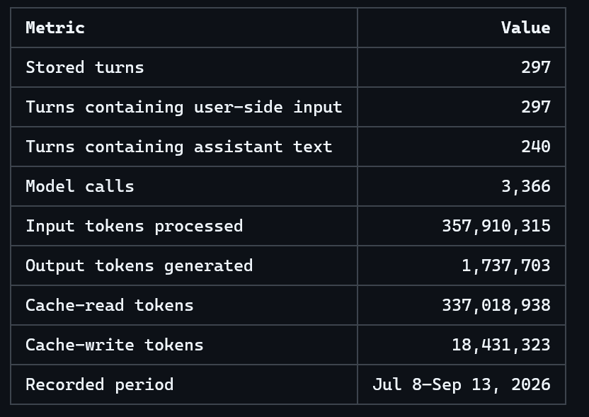
The session became the system
EXPERIENCE CURVE
Notes:
## Slide 6 — The session became the system
The first version of this system felt like extraordinarily capable vibe coding. One enormous worker session ran for weeks and accumulated more than twenty-four thousand AI credits. It knew the architecture, commands, release details, and previous decisions because it had lived through them.
A feature started with a detailed instruction describing product intent, UX and architecture constraints, and the release boundary. I then spent roughly an hour approving commands, refining the goal, and correcting design decisions as implementation emerged.
That was much faster than writing all the code myself, but it still required continuous attention. The session had become infrastructure—valuable infrastructure, but infrastructure that could not be reviewed, inherited, diffed, or reliably recreated.
Transition: “The first breakthrough was not a more elaborate prompt or a more capable coding agent. It was creating a durable contract outside the session.”

Slide 7
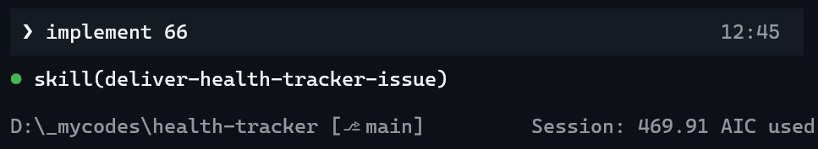
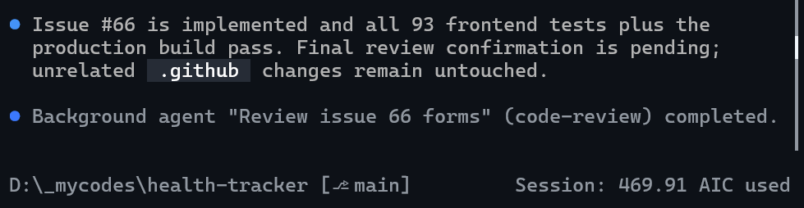
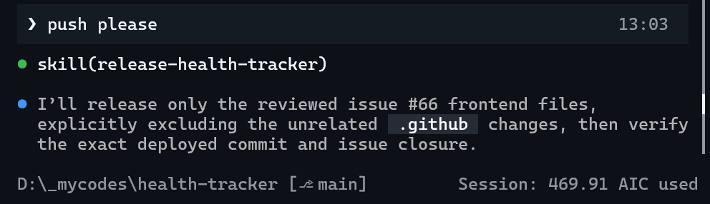
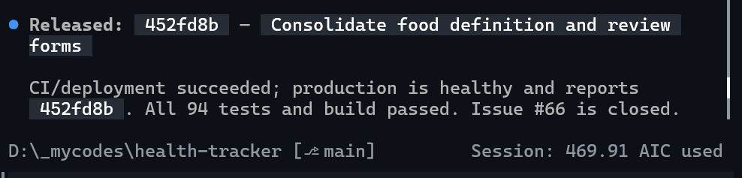
The prompt became three words
EXPERIENCE CURVE
Notes:
## Slide 7 — The prompt became three words
Fast forward. The visible implementation kickoff had become: “Implement issue 66.” The agent implemented the issue, validated it, and stopped at the release boundary. A later “commit and push” instruction invoked the controlled release procedure and production verification.
This slide shows the effect before explaining the mechanism. The short prompt was not evidence that prompting had become cleverer or that the model suddenly understood the product. It was evidence that the necessary context had moved somewhere durable.
The implementation and release still took meaningful elapsed time, but they no longer required continuous human steering.
Transition: “The first real breakthrough was not the three-word prompt. It was the contract that made those three words safe.”

Slide 8
The issue is the “API” between intent and implementation
BOUND THE WORK
WHAT NO LONGER NEEDS TO BE IN THE PROMPT
OUTCOME
Make energy balance understandable without treating missing data as zero.
Architecture recap
SCOPE
Dashboard calculations, chart controls, and account-scoped preferences.
Build and test commands
NON-GOALS
No nutrition-model redesign. No new data source.
Data-semantics rules
Use paired days only; preserve known values; keep controls accessible.
Accessibility patterns
ACCEPTANCE
Review boundaries
VALIDATION
Frontend/API tests plus independent diff review.
Release policy
RELEASE
Stop before commit, push, or deployment.
The short prompt works because the repository and issue carry the context.
Notes:
## Slide 8 - In my harness, the issue became the API between intent and implementation.
The issue was the first major breakthrough. Product intent no longer had to be rediscovered while code was being written.
This is a real Health Tracker example. Issue #95 was not simply “improve the dashboard.” Its outcome was to make energy balance understandable without turning missing data into zero. It constrained calculations to paired days, preserved known partial values, required accessible controls, and explicitly avoided redesigning the nutrition model.
An issue acts like an API because it defines the user-visible outcome, scope, non-goals, acceptance criteria, validation, and release boundary without prescribing every line of implementation. A fresh implementation session can reconstruct the necessary context from that issue and the repository instead of inheriting the shaping conversation.
Creating contracts this strong required bounded Product, Architecture, UX, and Security perspectives. At first, I coordinated those reviews manually. Once the issue existed, I could also encode the implementation and release procedures around it.

Slide 9
Creating the issue needed an engineering process too
SECOND LEARNING CURVE
1
RANDOM SESSION
2
MANUAL SHAPING
3
ENCODED SKILL
Single session
Shape & build
Shared session with specialist handoffs
One brief,
fresh reviews
Idea, requirements gathering and implementation in one session.
Product and architecture changed while code was already moving.
Dedicated “feature” session were Product, Architecture, UX ,
Security were specialized,
Communication and handoffs done via the session context,
The shaping skill orchestrates the process from idea to approved brief, specialists' reviews and enhancements from fresh contexts, and returns one issue draft.
OUTCOME
OUTCOME
OUTCOME
Decisions remained inside the worker session
Better focus - human still orchestrates
Repeatable process - human approves the contract
A reliable issue is produced—not prompted.
Notes:
## Slide 9 — The issue needed an engineering process too
The issue was the breakthrough, but it exposed a second learning curve: how do we produce a contract this complete reliably?
At first, shaping and implementation happened inside the same giant session. Product, architecture, UX, and technical decisions emerged while code was already moving. Generation was fast, but the contract remained implicit and easy to redefine.
The next version separated shaping from implementation. I used bounded Product, Architecture, UX, and Security agents to examine the idea before coding. The resulting issues were much stronger, but I was still the orchestration layer: switching agents, repeating prompts, carrying handoffs, and remembering which reviews each idea required.
Once that sequence became predictable, I encoded it as a shaping skill. The skill freezes one approved product brief, selects the relevant specialists, gives each a fresh bounded context, returns their reports to the shaping session, and produces an issue draft after I resolve material conflicts.
This is the first operational definition of the terms:
- Agents provide bounded lenses: a specific objective, context, and authority.
- Skills provide choreography: the repeatable sequence, routing, checkpoints, and boundaries.
The skill does not decide what the product should be. It makes the shaping process repeatable while preserving human decisions and the explicit issue-creation boundary.
A reliable issue is produced—not prompted.
Transition: “And just as the implementation prompt became three words, the visible shaping prompt became one ordinary product sentence.”

Slide 10
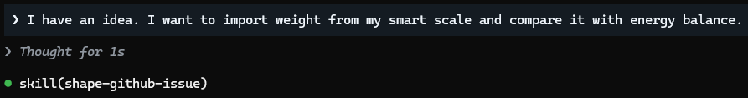
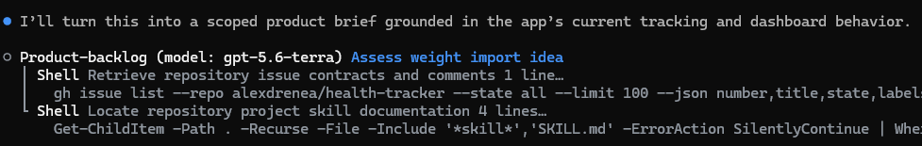
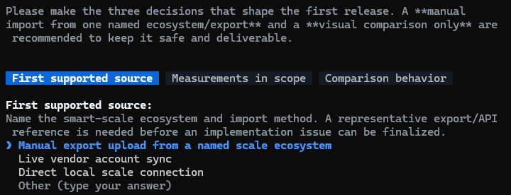
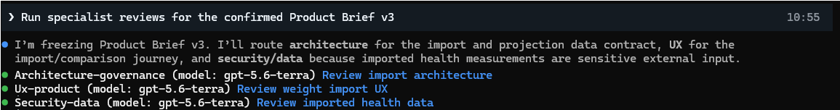
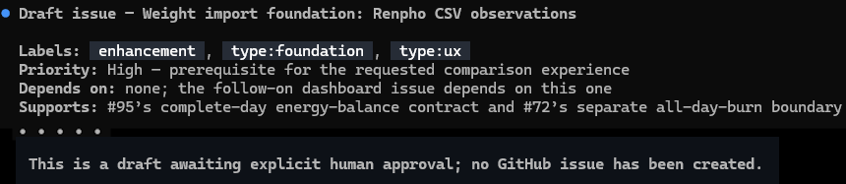
The issue began with one sentence
THE VISIBLE RESULT
Notes:
## Slide 10 — The issue began with one sentence
Slide 7 showed the visible implementation prompt shrinking to three words: “Implement issue 66.” This is the same progression on the other side of the contract.
Once the shaping procedure was encoded, issue creation could begin with one ordinary product sentence: “I have an idea. I want to import weight from my smart scale and compare it with energy balance.”
That sentence is not the issue, and it is not a magic one-shot prompt. It opens a structured conversation. The shaping skill carries the repetitive choreography: consult the repository and backlog, ask the consequential product questions, freeze the approved brief, route fresh specialist reviews, reconcile their findings, and produce the issue draft.
My work remains the part that requires judgment. I clarify the outcome, answer questions the repository cannot answer, resolve material tradeoffs, approve the contract, and separately authorize creation of the GitHub issue.
The screenshots should therefore show a progression rather than a single generation event:
1. The rough idea in the current session.
2. The shaping skill becoming active.
3. A concise issue draft or approval checkpoint.
4. A separate “Create the issue” instruction and the resulting issue identity.
This mirrors slide 7 deliberately. On the implementation side, “Implement issue 66” invokes an encoded delivery system. On the shaping side, “I have an idea…” invokes an encoded product-engineering process.
The prompt became shorter because the process around it became richer.
Transition: “The issue is now shaped, and implementation can be bounded by that contract. But implementation completion still produces only a candidate—not release confidence.”

Slide 11
From works on my machine to … works
THIRD LEARNING CURVE
1
IMPLEMENTATION SELF-CHECK
2
MANUAL REVIEW
3
ENCODED SKILL
Builder validates its own work
Human carries reviewer handoffs
One candidate,
fresh reviews
OUTCOME
OUTCOME
OUTCOME
Fast feedback
Independent perspective
Repeatable confidence gate
Correlated assumptions remain
Human still orchestrates
Human resolves material risk
Release confidence is produced, not inferred from implementation completion.
Notes:
## Slide 11 — Release review needed an engineering process too
The shaping side was not the only process that evolved. After implementation, I went through the same learning curve around releasing what we built.
The first version was implementation self-check. The same context interpreted the issue, wrote the code, ran the tests, and decided whether its own work was complete. That produced fast feedback, but the assumptions were correlated. The context most invested in making the implementation work was also the context judging whether anything had been missed.
Now, since I’ve been though this before, I skipped step 2 and went straight into encoding the process in a skill.
Once that sequence became predictable, I encoded it into the release skill. The skill freezes the candidate, selects fresh review objectives based on the issue, changed surfaces, and risk, reconciles the reports, stops for material human decisions, and repeats the relevant gate after every fix.
The skill does not make the release decision. It makes the evidence-producing process repeatable. The human still resolves material findings, accepts residual risk, and explicitly authorizes mutation.
This is the release-side equivalent of slide 9:
- Same context and implicit process.
- Fresh specialists with manual handoffs.
- An encoded skill with explicit checkpoints and authority boundaries.
Release confidence is produced—not inferred from implementation completion.
Transition: “That is the process. Issue #95 gives us one concrete example of why every stage mattered.”

Slide 12
Issue #95: fresh review changed the candidate three times
REAL RELEASE EVIDENCE
1
ARCHITECT CHECK
2
UX CHECK
3
PRODUCT CHECK
Does the result still satisfy the issue contract?
Does the runtime behavior still work?
What unrelated behavior changed in the final diff?
EXAMPLE
EXAMPLE
EXAMPLE
Known values disappeared
Exposed a concurrency issue on a new settings toggle.
iOS PWA regressed
Issue #95 · fresh review
Issue #95 · fresh review
Issue #95 · fresh review
The bugs are the example. Re-running the gate after every fix is the process.
Notes:
## Slide 12 — Issue #95: fresh review changed the candidate three times
Issue #95 is the evidence behind the process on the previous slide. These are not hypothetical reviewer categories; they are three findings from one real Health Tracker delivery.
The architect check found that a chart could say “not reported” even when one known burn component was present. The candidate technically rendered, but it violated the issue’s data-semantics contract by hiding known information.
The ux check found that rapid toggles could persist an older chart selection. The normal path worked, but concurrency meant the latest human choice could lose.
The final product check found that removing one Apple declaration regressed standalone iOS PWA installation. That behavior was outside the feature’s central path, which is exactly why a fresh final-diff review mattered.
The important pattern is not that these three specific bugs exist in every release. The pattern is that each finding changed the candidate. Once the candidate changed, the previous review result was no longer sufficient, so the release skill repeated the relevant gate before push.
The bugs are the example. Re-running independent review after every material fix is the reusable process.
Transition: “At this point, an experienced DevOps engineer may reasonably say: we already build, test, package, and deploy this way. So what exactly is agentic about the release flow?”

Slide 13
The release skill closes the loop around DevOps
AGENTIC CONTROL LOOP AROUND DEVOPS
release-health-tracker skill orchestrates the full control loop
HUMAN
Authorize release
RELEASE SKILL
Freeze candidate
FRESH AGENTS
Review candidate
HUMAN
Resolve risk
RELEASE SKILL
Invoke workflow
DEVOPS
Build + deploy
RELEASE SKILL
Verify prod identity
WHAT THE RELEASE SKILL ADDS
DETERMINISTIC DEVOPS
Routes fresh agents from diff + risk
Build, test, and package immutable artifact
Enforces stop and re-review boundaries
Deploy through protected environments
Reconciles issue, CI, and production evidence
Emit health, version, and telemetry signals
DevOps moves the artifact. The release skill proves the intended change reached production safely.
Notes:
## Slide 13 — The release skill closes the loop around DevOps
The answer is not that agents invented a better deployment pipeline. Good DevOps already builds, tests, packages immutable artifacts, moves them through protected environments, and exposes health, version, and telemetry signals. We should keep those deterministic controls.
The agentic contribution is the control loop around that pipeline.
The diagram makes ownership explicit. Yellow steps are human decisions. Teal steps are release-skill orchestration. Purple is fresh-agent judgment. Blue is deterministic DevOps. The release skill is not another deployment engine: it spans the control loop, routes the reviewers, invokes the workflow, and reconciles the evidence that comes back.
A human explicitly authorizes the release boundary. The release skill freezes the current candidate, examines the issue and actual diff, selects the required fresh reviews, and brings material findings back for human resolution. If a fix changes the candidate, it repeats the relevant gate. Only after confidence is established does it invoke or observe CI/CD.
After deployment, the skill does more than report that a command returned green. It correlates workflow results, target identity, application health, and the expected commit or version. If evidence conflicts, it reports the mismatch rather than returning a success-shaped answer.
So the responsibilities remain distinct:
- The human owns intent, material risk acceptance, release authorization, and rollback authority.
- Fresh reviewers provide independent judgment from bounded contexts.
- The release skill orchestrates the checkpoints, evidence, retries, and stop conditions.
- DevOps workflows deterministically build and move the artifact.
In this single-maintainer repository, the mutation boundary may be “commit and push.” At enterprise scale, the same control loop should operate through protected pull requests, CODEOWNERS, required checks, environment approvals, and auditable identities.
DevOps moves the artifact. The release skill proves that the intended change reached production safely.
Transition: “Once idea-to-issue, issue-to-candidate, and candidate-to-production were all explicit, the practical change in my own work became visible.”

Slide 14
The hour stayed. My job changed.
EXPERIENCE CURVE
1. Issue shaping session
2. Implement session
“I have an idea”
“Implement issue 66”
Shaping skill
Delivery Skill
Collaborate to create brief
Commit and push
Long-running worker session
Specialists enhance
Release skill
Detailed prompts +
live supervision
Create issue
Verified release
The practical result
10–15 min shaping • ~45 min agent execution • roughly the same hour, with far less synchronous attention.
Three transitions became repeatable: idea → issue → candidate → production.
Notes:
## Slide 14 — The hour stayed. My job changed.
This is the Health Tracker harness as an end-to-end lifecycle. It encodes three transitions:
1. Idea to approved issue: the shaping skill clarifies intent, freezes a product brief, invokes Product and the relevant Architecture, UX, and Security/Data specialists in fresh bounded contexts, and returns an issue draft for human approval.
2. Approved issue to reviewed candidate: the delivery skill reconstructs context from the issue and repository, implements the change, validates it, and stops before release.
3. Reviewed candidate to verified production: explicit “commit and push” authorization invokes the release skill, independent review, validation, CI/CD observation, and exact production identity checks.
I originally performed the shaping handoffs manually. Once the sequence became predictable, I encoded it as a skill. The skill did not replace product judgment; it removed repetitive orchestration around that judgment.
My work became framing outcomes, answering consequential questions, resolving specialist tradeoffs, approving the contract, and deciding when release risk was acceptable. The system performed the long implementation and verification work.
The practical result remained approximately ten to fifteen minutes of focused shaping followed by roughly forty-five minutes of agent execution. The hour stayed. My job changed.
Transition: “I did not set out to build something called an agentic harness. I encoded one painful transition at a time. When I stepped back, this was the system that had emerged – I don’t claim that this is complete, authoritative, or that it works as is for everyone, but it worked for me.

Slide 15
Anatomy of a repository-native agentic harness
CONTROL SURFACES
Issues
Specialist agents
Instructions
Outcome, scope,
acceptance, dependencies
Bounded, read-only
analysis
Stable architecture,
commands, invariants
Repository-native
engineering system
Workflows
Deterministic gates +
artifact movement
Path rules
Skills
Localized backend,
UI, workflow rules
Tests + evals
Repeatable multi-step
procedures
Executable
invariants
Notes:
## Slide 15 — Anatomy of a repository-native agentic harness
What emerged was not one magical agent. It was a set of control surfaces, each carrying knowledge with the right lifetime and authority.
- Instructions own stable architecture, commands, invariants, and safety constraints.
- Path rules narrow those instructions where backend, UI, infrastructure, or workflow behavior differs.
- Issues own change-specific product intent: outcome, scope, non-goals, acceptance, dependencies, and required validation.
- Specialist agents provide bounded analysis from fresh contexts.
- Skills encode repeatable multi-step transitions such as shaping, delivery, release, and local-data setup.
- Tests and evaluations own executable behavior and regression truth.
- Workflows own deterministic gates and artifact movement.
A session owns temporary conversation and execution. It should not be the only home of durable engineering knowledge.
This slide names the reusable architecture. The previous slide showed my concrete implementation of it.
“I spent 60 days learning, through delivery and failure, what these emerging principles mean operationally. Here is the concrete harness that emerged, where it worked, where it failed, and where human judgment still mattered.
Transition: “The live demo will exercise the first two rows: one rough idea becomes an issue draft, then one approved issue becomes a candidate—stopping before either mutation boundary

Slide 16
Skills orchestrate the lifecycle. Agents stay bounded.
CHOREOGRAPHY + AUTHORITY
TRANSITION | ORCHESTRATING SKILL | BOUNDED SPECIALISTS + EVIDENCE | HARD STOP / AUTHORITY
IDEA → ISSUE DRAFT | shape-github-issue | Product/Backlog Architecture · UX · Security/Data as risk requires | Human approves brief + draft Separate instruction creates issue
ISSUE → CANDIDATE | deliver-issue | Core implementation Repository instructions · tests · targeted validation | Candidate only No commit, push, or release
CANDIDATE → PRODUCTION | release-health-tracker | Fresh risk-routed review CI/CD + health + exact version evidence | Human resolves findings + authorizes consequential actions Environment controls deploy
Role
Primary job
Write access
Release authority
Skills own the sequence. Agents provide bounded judgment.
Humans authorize consequential actions.
Notes:
## Slide 16 Skills orchestrate the lifecycle. Agents stay bounded.
The previous slide listed the parts of the harness. This slide shows how those parts compose in execution order.
The first transition is idea to issue draft. The `shape-github-issue` skill owns the choreography in the current session. It consults Product/Backlog and routes fresh Architecture, UX, and Security/Data reviews when the risk requires them. Those specialists provide bounded judgment; they do not create the issue or implement code. The human approves the brief and draft, and issue creation requires a separate instruction.
The second transition is issue to candidate. The `deliver-health-tracker-issue` skill bounds the core implementation capability. There is intentionally no fictional “developer agent” in the specialist list—the agent itself can implement. The skill reconstructs context from the approved issue and repository, runs the required validation, and stops before commit, push, or release.
The third transition is candidate to verified production. The `release-health-tracker` skill routes fresh review based on the actual diff and risk, reconciles findings, invokes or observes deterministic CI/CD, and verifies production health plus exact identity. The human resolves material findings and explicitly authorizes mutation; workflow and environment controls perform the deployment.
This is the distinction to remember:
- Skills own sequence, routing, checkpoints, and stop conditions.
- Agents provide bounded expertise and independent judgment.
- Tests and workflows provide deterministic evidence and artifact movement.
- Humans own intent, material risk, and mutation authority.
The ordering matters because each stage produces the contract consumed by the next stage, and no stage silently inherits the authority of the following one.
.”

Slide 17
Shape intent, then build from the contract
LIVE DEMO · TWO CONTROLLED TRANSITIONS
1 · SHAPE
“I want to import weight from my smart scale...”
Issue draft only. No GitHub mutation.
2 · DELIVER
“Implement issue 66.”
Reviewed candidate only. No commit or push.
WHAT TO WATCH
Rough idea → approved brief
Fresh specialist reviews
Durable issue draft
Existing issue → candidate
Two explicit stop boundaries
Draft only - no issue creation
Candidate only - no commit or push
Authorizes every consequential action
SHAPE
DELIVER
HUMAN
Notes:
## Slide 17 — Shape intent, then build from the contract
/model luna
/permissions allow-allow
Product:
I want to import historical weight measurements from my smart-scale
export and compare the trend with energy balance.
Please update brief with architect and UX specialist guidance into a complete
issue draft.
------
This is one live demonstration in the real Health Tracker repository. It shows the two generative transitions while deliberately stopping before either mutation boundary.
Part one begins with a rough product idea: “I want to import weight from my smart scale and compare it with energy balance.” I invoke the shaping skill. Watch it clarify consequential product intent, freeze the approved brief, route fresh Product, Architecture, UX, and Security/Data reviews, reconcile their findings, and produce a durable issue draft.
The first stop boundary is explicit: do not create or update a GitHub issue. The output is a draft for human judgment.
Part two begins from an existing approved issue with a short instruction such as “Implement issue 66.” The delivery skill reconstructs context from the issue and repository, implements the bounded change, runs validation, and produces a reviewed candidate.
The second stop boundary is also explicit: do not commit, push, or release. The output is a candidate for human acceptance and the separately authorized release procedure.
This is intentionally not a live production deployment. The point of the live demo is to show that a rough idea and a short implementation prompt work because the harness carries the contracts, specialist choreography, validation, and authority boundaries. The real Issue #95 controlled-release replay remains available in the backup slides as production evidence.
Target timing: approximately three minutes for shaping and two minutes for delivery. If either operation runs long, stop after showing the frozen brief or implementation plan and summarize the expected bounded output.
Transition: “The demo shows my implementation. Only later did I notice how closely its principles converged with the official direction.”

Slide 18
INDEPENDENT CONVERGENCE
The principles converged. The implementation remained local.
OFFICIAL DIRECTION | MY IMPLEMENTATION
Structured inputs, outputs, and success criteria | The issue became the API
Separate planning, reasoning, and execution | Idea → issue → candidate → verified production
Multi-agent coordination and isolation | Risk-routed specialists in fresh contexts
Risk-based guardrails and intervention | Explicit stage boundaries and consequential approvals
Evaluation and durable state | Re-review changed candidates; persist decisions and evidence
GitHub as system of record and control plane | Issues, instructions, tests, workflows, commits, and deployment identity
Converge on engineering principles. Let teams own their implementation.
18
Notes:
## Slide 18 - The principles converged. The implementation remained local.
“I did not design this by transcribing a reference architecture. I encoded one lesson at a time as the system failed, scaled, and became harder to operate. When I later compared the result with GitHub’s agentic SDLC guidance, the direction was strikingly similar. What follows is not the official architecture—it is one field-tested implementation of those emerging engineering principles.
The official language is structured tasks, separation of planning and execution, durable state, isolated agents, evaluation, guardrails, and GitHub as the control plane.
My language was more concrete and more local: the issue is the API; three transitions; fresh specialist reviews; every changed candidate is reviewed again; verify the exact version in production.
I did not arrive at one official reference architecture. I arrived at one implementation of the same emerging engineering principles.
And that distinction matters in an enterprise. We should converge on the principles and required controls - not require every product to use the same agents, skills, or workflow topology.
"The natural next question was: could I lift this harness and apply it to another project?".

Slide 19
THE NEXT QUESTION
Could a working harness travel to another product?
1
QUESTION 1
2
QUESTION 2
3
QUESTION 3
Would it still be helpful?
How to find new product's context?
What about change management?
Port the engineering behavior. Re-learn the product truth.
19
Notes:
## Slide 19 - Could a working harness travel to another product?
After the first product, the natural next question was how can I reuse what I’ve learned, in another project.
I wanted to reuse the engineering behavior I had proven: the agents and skills, the review and delivery choreography, and the shared engineering conventions.
But obviously, the other project won’t have the same product background, likely not share the same architecture, so I had to extract a “starter kit”
I was also wondering if I made this too “embedded” would this harness work for another project ? How would it work and how would I manage these versions now.
We will cover answers to all these questions in the next couple slides.

Slide 20
First separate product truth from harness behavior
REUSE STARTS WITH A BOUNDARY
PRODUCT KNOWLEDGE - STAYS LOCAL
HARNESS BEHAVIOR - CAN TRAVEL
Architecture and domain rules
Agents and skills
Operational and deployment facts
Structural references: where to look
Issues, tests, and product decisions
Repeatable review and delivery choreography
Repository documentation
Shared engineering conventions
A portable harness knows the paths to product truth. It does not carry the product truth.
Notes:
## Slide 20 - First separate product truth from harness behavior
Before we can share anything, we needed a boundary.
The product repository remains the authority for product knowledge: its architecture, domain rules, operational and deployment facts, issues, tests, and durable documentation. That knowledge should stay local because it is true for this product, not every product.
The harness is different. Its portable layer contains agents, skills, shared engineering conventions, and repeatable review or delivery choreography. It should point to the product's durable context by repository-relative structure - for example, "read the architecture decisions under docs/decisions" - without carrying or inventing the decisions themselves.
That is the design discipline we have been applying already. A portable harness knows where product truth belongs. It does not claim to own that truth.
Transition: "Once we have separated those two things, the question changes. The hard part is no longer copying a few files once. It is managing their change over time."

Slide 21
We already solved this problem for code
COPYING IS NOT A CHANGE STRATEGY
COPIED HARNESS
Project 1 .github/...
Project 2 .github/...
Project 3 .github/...
Which version is current?
Which change reached every project?
Where did the copies drift?
One package source
Versions + lockfile
A single home for reusable behavior
A known dependency, not an anonymous copy
Install + update
Audit drift
Deliberate propagation instead of ad hoc replacement
Detect changes to the deployed copy
The familiar answer
Package reusable behavior; consume it as a dependency
Code gave us NuGet and npm. APM applies the same discipline to agent context.
Notes:
## Slide 21 - We already solved this problem for code
Once a harness has been proven reusable, copying it is not the hard problem. Managing change is.
I can copy five agents and skills into projects two, three, and four today. But the first useful improvement immediately raises the same questions software teams already know: which version is current, which products received the update, where did a local edit create drift, and how do we review an upgrade?
We solved this for code with NuGet, npm, Maven, pip, and every other package manager. We keep one package source, version it, lock the dependency a consumer actually accepted, update deliberately, and audit what is installed.
APM applies that familiar discipline to agent context. It is not a new operating model. It is a package-management answer to the same source, version, propagation, and drift problems - for agents and skills rather than application libraries.
Transition: "So what does APM actually do between that shared source and a consumer repository?"

Slide 22
One source. Controlled installation in every consumer.
APM IS THE DISTRIBUTION LAYER
HARNESS PACKAGE
1
Source of truth: apm.yml + .apm/agents + .apm/skills
apm install
2
Resolves the declared package version and records it in apm.lock.yaml
CONSUMER OUTPUT
3
Deploys generated agents and skills to the Copilot locations the project uses
Edit the package source, not the deployed consumer copy.
Consumers own product context, not a forked shared harness.
Notes:
## Slide 22 - One source. Controlled installation in every consumer.
This is the operating model in one picture.
The shared harness package owns the editable source: its manifest and the .apm source tree containing agents and skills. The consumer project declares which package version it wants in its own apm.yml.
When the consumer runs apm install, APM resolves that version, writes the resolved commit and content hashes into apm.lock.yaml, and deploys the files into the harness-native locations that your agent can read. One caveat, and what makes APM a great tool is that you do not have to worry about what agent UI you are using. As you know, various plafroms use different conventions, and concepts, - but t apm can apply these files according to the agent you are using – claude, codex, copilot, other.
The important clarification is that the package source lives in .apm in the authoring package. The consumer does not edit a .apm copy of that shared package. It receives generated, harness-native files in its project.
That creates a clean ownership boundary. The consumer owns its product context. The package owns the shared harness behavior.
Transition: "You do not need an enterprise catalog to start. The distribution mechanism can evolve with the scope of reuse."

Slide 23
Start local. Move only when sharing earns it.
EVOLVE WITH REUSE
1. LOCAL PATH
2. PRIVATE GIT
3. MARKETPLACE
Fast authoring and testing
One person / early alpha
Tags, review, and versioned updates
Shared across projects
Curated discovery and approved catalog
Organization scale
FIELD-TESTED START
THE RULE
Local-path development: evolve and test one harness against a real product
Private Git is the next step for shared use. A marketplace is optional - not the starting line.
Notes:
## Slide 24 - Start local. Move only when sharing earns it.
APM does not require a registry or a marketplace on day one.
The first stage is a local filesystem path: a sibling harness folder that one person can edit and test against a real product quickly. That is the field-tested starting point in this story.
When more than one repository needs the same stable behavior, move the source to a private Git repository. Tags, pull-request review, and lockfiles give consumers a reproducible and reviewable update path.
Only later, when many teams need to discover approved packages, does a marketplace become useful. It is a catalog and discovery experience - not a prerequisite for packaging or private reuse.
The rule stays constant through every stage: centralize proven shared harness behavior; keep architecture and operational truth local.
Transition: "This progression comes with a tradeoff. But it is one software engineers already understand."

Slide 24
APM DEMO
APM IN ACTION
Notes:
cd D:\_mycodes\prdc2026\_artifacts\agentic-sdlc-github-azure\demo\my-new-app-clean
<duplicate> powershesll
shell1:
copilot
-/agents -> no local agent
<move to shell 2>
shell2:
apm install d:\_mycodes\__apm\alex-agentic-harness-v1 --target copilot
<move to shell 1>
/restart
/agents -> shows agents
where should I put product context => agent context
implement issue 1 -> show picking up the delivery agent

Slide 25
SESSIONS ARE DISPOSABLE.
ENGINEERING MEMORY IS NOT.
Your call to action
Take one repeated lesson out of chat and place it into a versioned, reviewable control surface.
The durable advantage is not the model. It is the engineering system that helps people and models produce trustworthy change together.
Thank you
Notes:
## Slide 25 — SESSIONS ARE DISPOSABLE. ENGINEERING MEMORY IS NOT.
“Let me return to the incident.
Recovery was fast because architecture, deployment intent, health behavior, and operational knowledge were discoverable. The incident still happened because one mutation boundary lacked a safe invariant. AI amplified both the strength of the system and the weakness in the system.
That is why hypervelocity is not typing code faster.
It is making intent clear, feedback fast, failure recoverable, and every lesson reusable.
Use agents to accelerate the loop.
Use evidence to constrain the agents.
Use packages and platforms to compound the learning.
Tomorrow, take one engineering lesson that currently lives in a person’s head or an old chat. Move it into an executable, reviewable control.

Slide 26
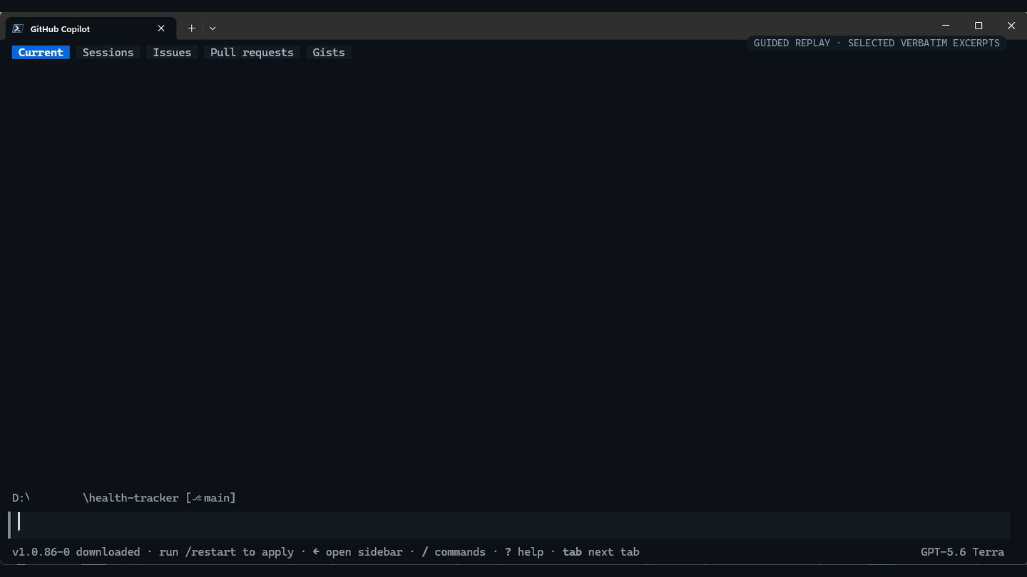
Issue #95: two prompts, one controlled release
BACKUP · 90-SECOND REPLAY · REAL HEALTH TRACKER SESSION
90-second guided replay · selected verbatim excerpts · explicit time jumps
1 DELIVERY CANDIDATE
2 RELEASE AUTHORIZATION
3 VERIFIED OUTCOME
> please start work on 95
[agent] Issue #95 loaded
[agent] Candidate implemented
[tests] Focused checks pass
[boundary] Await release authorization
> verify the ticket;
if complete, commit and push
[release] Candidate frozen
[review] iOS PWA regression
[fix] Corrected + re-reviewed
[gates] Final validation passed
commit 2067c5c
workflow 34311026424 PASS
health HTTP 200
version 2067c5c
issue #95 CLOSED
Fresh context -> code + tests -> stop
Authorization starts gates; it does not bypass them
Exact release identity + operational health
My interaction became smaller because the engineering system became richer.
Notes:
## Backup slide 26 — Slide 17 demo video - Issue #95: two prompts, one controlled release
**Format:** 90-second guided replay built from selected verbatim excerpts of the real Health Tracker issue #95 session. The replay uses explicit time jumps; it is not presented as a continuous real-time recording.
### Before playback
“This is a guided replay of a real delivery, not a simulated live-coding performance. The words are selected verbatim excerpts. The visible jumps are where I have compressed implementation, testing, and human review.”
**Action:** Click directly on the video once. Do not advance the slide until the final evidence frame appears.
### 0:00–0:15 — A small prompt enters a rich system
“The visible instruction was only: ‘please start work on 95.’ The response was not immediate code generation. The delivery session first reconstructed the issue contract from the issue, repository instructions, code, and tests.”
### 0:15–0:31 — Candidate implementation, then a boundary
“The replay compresses the implementation and focused validation. Notice the agent reaches a reviewed candidate, but it still does not own release authority.”
### 0:31–0:45 — Human release authorization and explicit risk ownership
“My second instruction was to verify the complete ticket and release only if it was ready. A timing-sensitive, unrelated benchmark remained. I explicitly accepted that exception; the system did not silently redefine success.”
### 0:45–1:02 — Fresh review changes the candidate
“The independent final review found a release-blocking iOS PWA regression. The implementation restored compatibility and ran the review again. Fresh context is not theater here: it changed what would have shipped.”
### 1:02–1:22 — The exact candidate becomes a release
“Only after the clean re-review did the skill stage the reviewed scope, create commit 2067c5c, push it, and follow the exact GitHub Actions run.”
### 1:22–1:30 — Production evidence
“The workflow completed, production health passed, and the deployed version reported 2067c5c. Issue #95 closed. My interaction became smaller because the engineering system became richer.”
### Accuracy guardrails
- The benchmark exception was explicit human risk acceptance, not a hidden pass.
- Health plus exact version proves operational release identity, not that every feature behavior is defect-free.
- Security and architecture review are risk-routed inside the release skill; independent code review is always required.
- Direct-to-main is specific to this single-maintainer repository, not the enterprise default.
### Transition
“This worked because one repository had accumulated these instructions, roles, tests, and release controls. Then I tried to give the same capability to another repository.”

